Slide 1
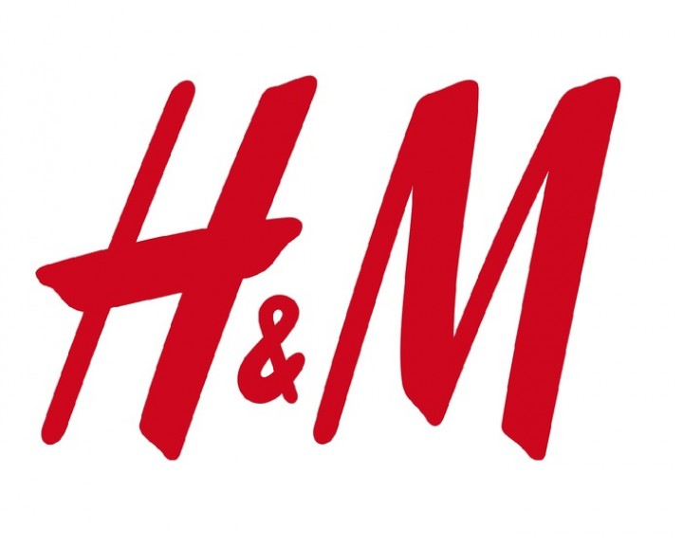
Melissa Halik, Matt Domagala, Ali Abuihmoud and Marcus McMath

Slide 2
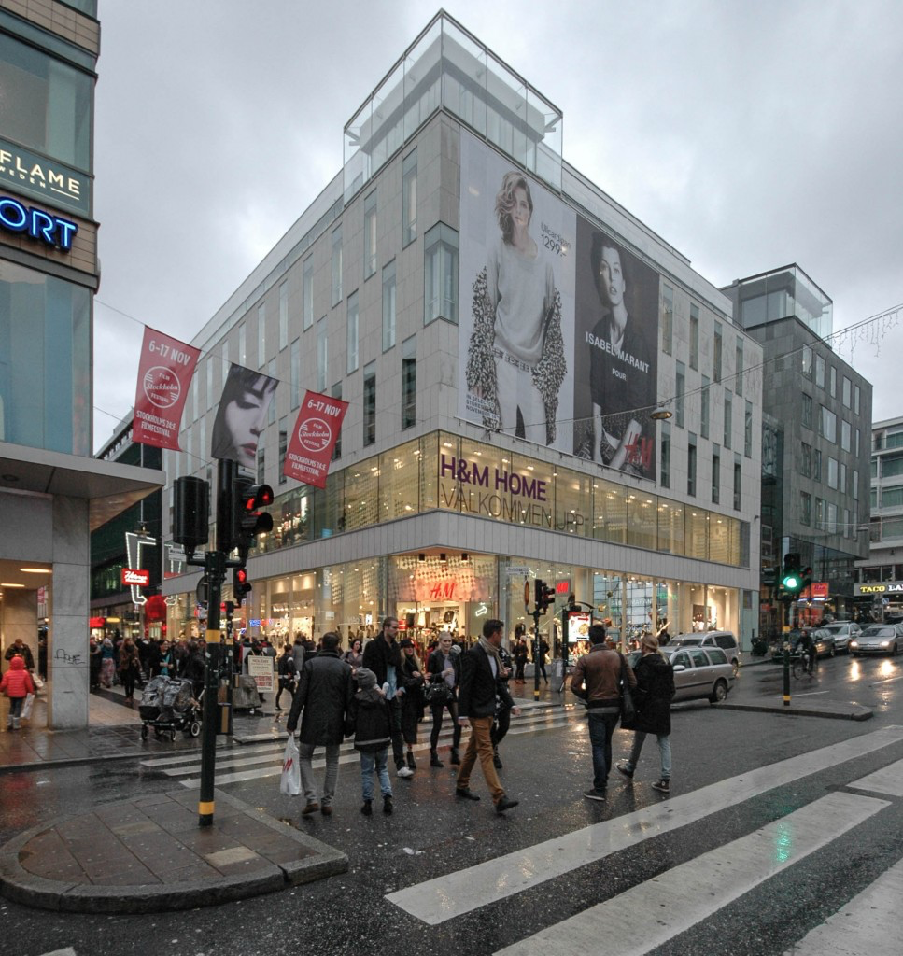
Executive Summary
Erling Persson, Hennes in 1947
Mauritz Widfross in 1968
Huge inventory issues
Inferior to competitors
The Year of Transformation

Slide 3

Background
1947-1959
1947 Persson open first store in Sweden
1960-1979
Name change to H&M
1980-1999
Offer online shopping
2000-2009
First store in U.S.
2010-Present

Slide 4
The Problem
Had more than $4.3 billion dollars of unsold inventory.
Had a drop in quarterly sales
Causes an increase in markdowns.
Net income crashed by 11% back in January 2017.
Two reasons why H&M is struggling:
Slow supply chain management.
Has double the lead time.
Many customers have been moving towards their other competitors, like Zara, and online stores.

Slide 5
The Cause
Online store have been pulling in many of the customers due to the speed and the price of their items.
With people constantly being in the stores, they turn to shopping online.
Causes loads of inventory in each store to be untouched.
H&M is on a legacy infrastructure, but has slowly been trying to improve their IT infrastructure.

Slide 6
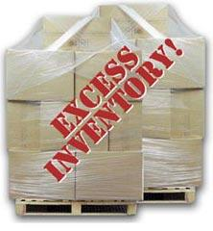
Results/Solutions
Get rid of excessive inventory
Increase markdowns on outdated products
Could lead to lower profits and sales
Investing heavily in supply chain technology
New logistic systems, advanced analytics to predict consumers wants
Ship them to new foreign markets
Asia, Latin America

Slide 7
Cont.
Faster supply chain processes
80% of their suppliers are in Asia, Southeast Asia
Have more offices in the region
Better communication, better processes
Faster delivery
Move suppliers to Eastern Europe
Turkey
Cheap, quicker deliveries to Europe and US
Adapt to fashion trends quicklier, leads to lower unwanted inventory
Cut lead time to half
Build a better, more efficient automated warehouses
Better technology foundation, better data

Slide 8

Cont.
Reaching out to consumers
Improve shopping experiences
Improve online sales
Afound store- widen popularity
Customer service

Slide 9
Questions
With regards to the $4.3 billion of unsold inventory, what would be the best solution for H&M to proceed with?
How can H&M become a better competitor with companies such as Zara?

Slide 10
References
https://www.businessinsider.com/why-hm-business-is-struggling-201804
https://consumerist.com/2017/03/30/hms-supply-chain-problems-could-translate-to-discounts-for-shoppers/

